Slide 1




From Forms to Dataset
Pablo Nguema
Thomas Childers
Siva Venna
Hamza Mahmood

Slide 2
Outline
The objective is to turn a list of scanned and typed document into a dataset that would be quarriable
In our case we worked with 77*5 forms (77 unique names and 5 different forms)
Steps:
Classify the different pages of the Forms where the text would be extracted
Extract the text form the classified forms and put them in a dataset

Slide 3

Form Classification
The objective of the step is to train a model that would be as accurate as possible when classifying.
Using TensorFlow and Keras
The model picked was VGG16,since it was the model with the highest accuracy

Slide 4
Confusion Matrix
Forms | A | B | C | D | E
A | 77 | 0 | 0 | 0 | 0
B | 0 | 77 | 0 | 0 | 0
C | 0 | 0 | 77 | 0 | 0
D | 0 |  |  | 77 | 0
E | 0 | 0 | 0 | 0 | 77
z

Slide 5
Results of the Classification
The accuracy score of the model was 100%
It classified each page in each pdf perfectly

Slide 6
Text Extraction
Use of bounding areas where the desire text would be found
The service used to OCR was AWS Extract as it allows extraction from typed and handwritten forms
End product was CSV data frame that has the necessary information

Slide 7
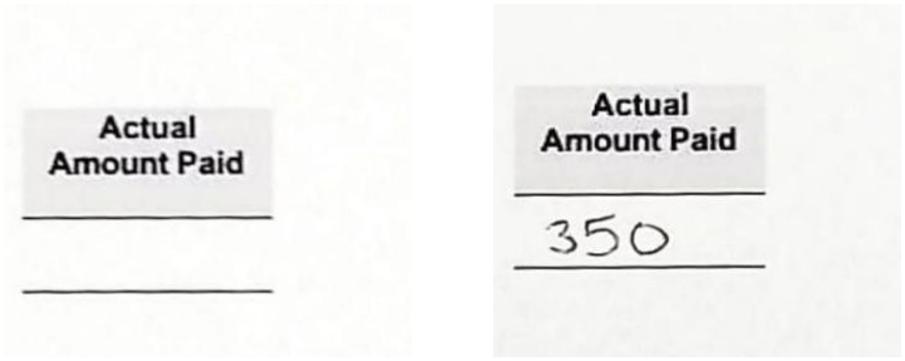
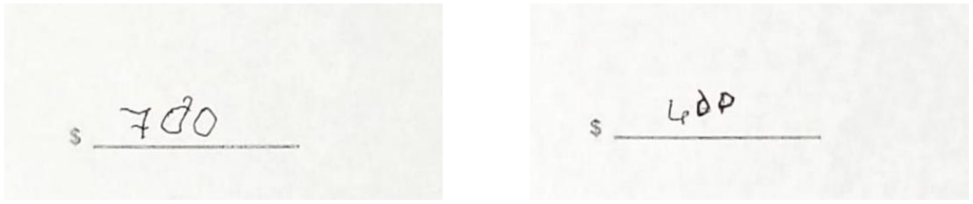
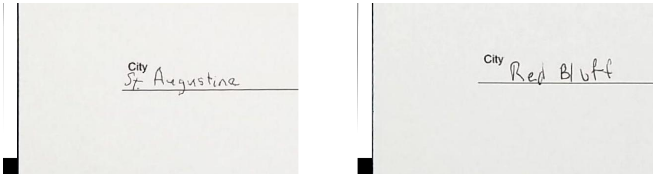
Bounding Boxes(Examples)
Bouding Boxes Display

Slide 8
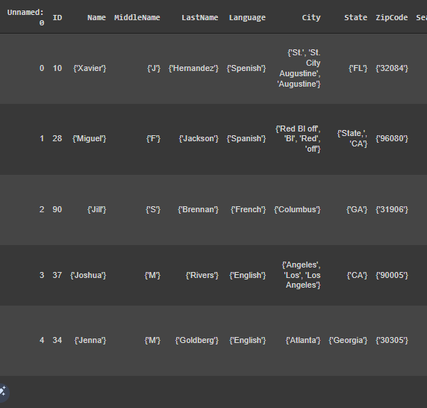
Dataset Demo
Full Table Link

Slide 9
Conclusion
The pipeline would be in route to deployment within 2-3 weeks as the current end product(the demo) has room for improvement
The next steps would be a following Flagging function that would allow automatic data cleaning

Slide 10


Slide 11
APPENDIX
z

Slide 12
Notebooks
Classification Notebook :Image Classification
Test Notebook: Text Extarction
Holography Notebook: Homography Test

Slide 13
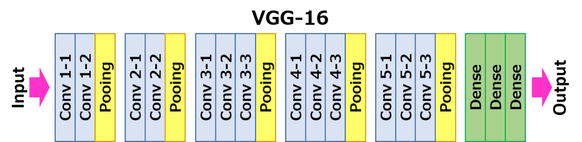
VGG16. Definition and Structure
VGG16 is a convolutional neural network model proposed by K. Simonyan and A. Zisserman from the University of Oxford in the paper “Very Deep Convolutional Networks for Large-Scale Image Recognition”.
VGG16 Explination

Slide 14
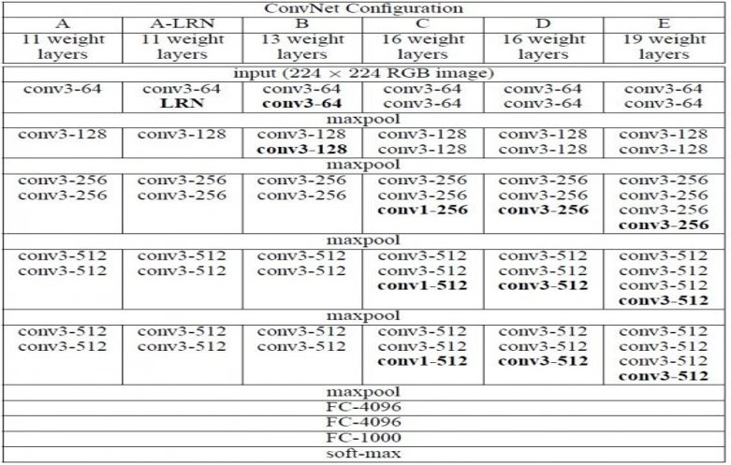

Slide 15
AWS Textract
Amazon Textract is a machine learning (ML) service that automatically extracts text, handwriting, and data from scanned documents. It goes beyond simple optical character recognition (OCR) to identify, understand, and extract data from forms and tables.
Extracts text in blocks which is seen as a list of dictionaries
AWS Textract Link

Slide 16
Homography
homography is an isomorphism of projective spaces, induced by an isomorphism of the vector spaces from which the projective spaces derive. Homography Link
In the field of computer vision, any two images of the same planar surface in space are related by a homography (assuming a pinhole camera model). This has many practical applications, such as image rectification, image registration, or camera motion—rotation and translation—between two images. Once camera resectioning has been done from an estimated homography matrix, this information may be used for navigation, or to insert models of 3D objects into an image or video. Homography in CV

